Slide 1


Integrated development Project
The development and Conception of a Customer relationship management System
The 25th of February 2019

Slide 2
Our Team layout
Ons Bellazreg
Emna Abid
Cyrine Jouini
Selim Hadhri
Islam Ben Fredj
Marwen Saidi

Slide 3




plan
Introduction
Project specifications
use case diagram
Project context

Slide 4



plan
Scenario & Mock-up
Global Architecture
Conclusion
Static analysis

Slide 5




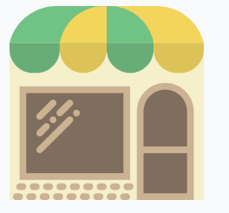
Introduction
CRM
Interaction with Customers
Increasing sales
Communication resolutions
Store & stock organization

Slide 6






Problematic
A bad management of stores (stock deficiency..)
Clients Have difficulties choosing the right Offers/Products
Marketing Stratigy that can be improved
Low interraction quality
Hard to find a close by store
Loss of Clients

Slide 7



Existant Solutions
CRM
Salesforce
Blue note
Oracle E-Business Suite

Slide 8




Our Solution
Easy To find adequate Products
Better Customer/Operator Interractions
Allows to find the closeset store
Financial Service that is easy for the clients
Customer
Satisfaction

Slide 9






Actors
IT manager
HR director
Commercial director
Director of support services
Communication and
marketing director
Commercial employee

Slide 10





Functional requirements
Create and Manage Accounts
Shop and buy products easily
Send claims if needed
Manage the employees
Manage to select a target for promotions

Slide 11






Non-functional requirements
Security

Slide 12

Performance

Slide 13

Maintainability

Slide 14
Reliability

Slide 15
Availability

Slide 16
Usability

Slide 17
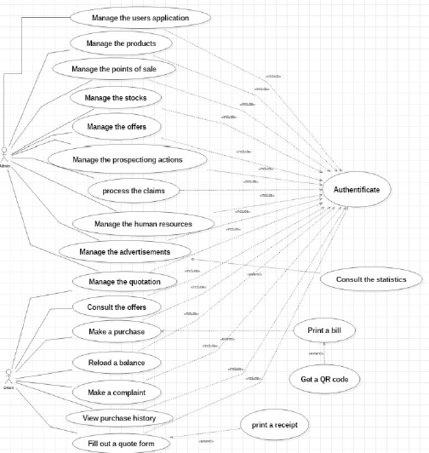
use case Diagram

Slide 18
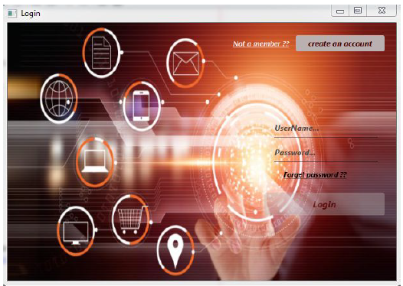
Scenario & Mock-up
Admin login Mock-up

Slide 19
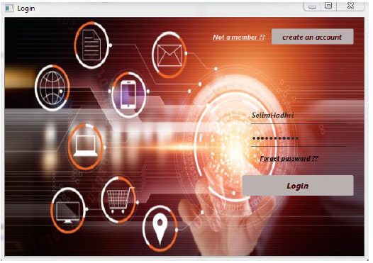
Scenario & Mock-up
Entering password and email Mock-up

Slide 20
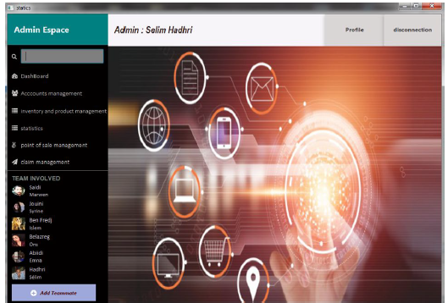
Scenario & Mock-up
Commercial director functionalities Mock-up

Slide 21
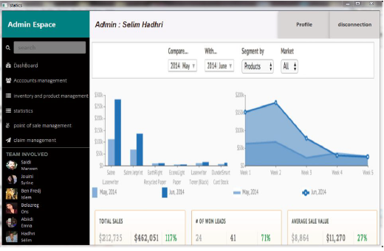
Scenario & Mock-up
Statistics automatic generation Mock-up

Slide 22
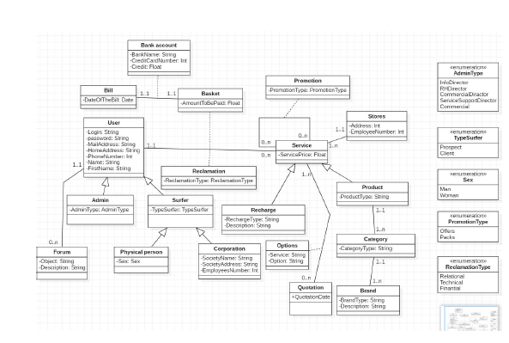
Global analysis class diagram

Slide 23
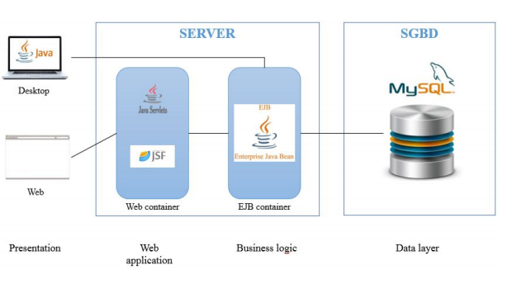
Global architecture

Slide 24
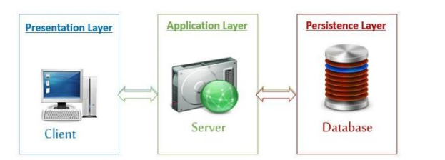
Global architecture
Logical architecture
Different layers of 3-tiers architecture
The n-tiers architecture (distributed architecture, or multi-tier architecture) is a client-server architecture in which presentation, application processing, and database management layers are separated.

Slide 25
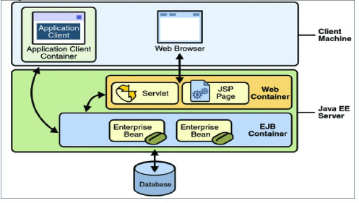
Global architecture
Physical architecture
Physical architecture : 3-tiers
3-tier architectures provide many benefits for production and development environments by modularizing the user interface, business logic, and data storage layers.

Slide 26
Conclusion
High performance
customer retention
Possibility to integrate new features
Notes:
Increase customer conclusion

Slide 27

Thank you for your Attention

